Slide 1
Final Project
Progress Update
Ethan Ward S182964

Slide 2
Project proposal
Can a modular 3D player controller developed in Unity offer greater accessibility to non-programmers as an industry tool?
What is a player controller?
A player controller is a script that is attached to a character of a game which allows the user to enter different values for different character attributes.
Notes:
My original project proposal was:
Can a modular 3D player controller developed in Unity offer greater accessibility to non-programmers as an industry tool?
But before we can answer that question we need to know, What is a player controller?
A player controller is a script that is attached to the character of a game which allows the user to enter different values for different character attributes.

Slide 3
What I hope to achieve
To be able to use C# and Unity to create a downloadable player controller capable of being attached to game character enabling easy editing of common attributes for non-programmers.
Notes:
What I hope to achieve from this project is
To be able to use C# in Unity to make a downloadable player controller that a non programmer can attach to their game character that will then enable them to easily edit common attributes to test their game.

Slide 4

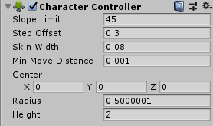
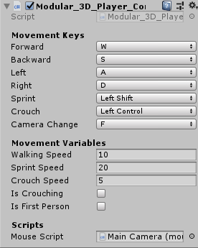
Proposal feedback
“The proposal is to make a character controller, this is common functionality within game engines”
Notes:
One of the pieces of feedback I received was that:
“The proposal is to make a character controller, this is common functionality within game engines”
While it is true that game engines already contain Character Controllers, as the top picture shows, you still need programming knowledge to make them work.
They aren’t a drag and drop solution and do not enable non programmers to get a playable character within their application.
As you can see from the bottom picture, which is a current screenshot of the character controller I am developing, It adds in a lot more functionality to the user and enables a drag and drop solution.

Slide 5
Proposal feedback – Cont.
“your project title asks if a modular player controller can offer greater accessibility to nonprogrammers, but nowhere in your proposal do you discuss how you will actually answer that question.”
Notes:
Another bit of feedback I received was that no where in my proposal did I actually attempt to answer my original question.

Slide 6
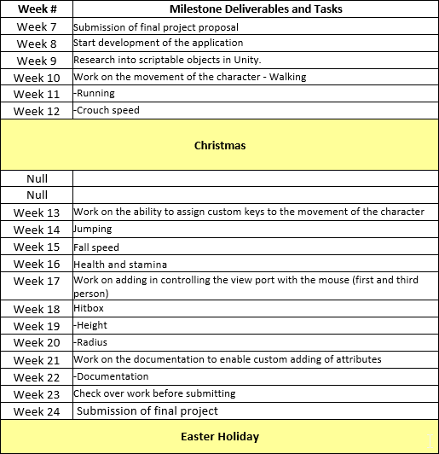
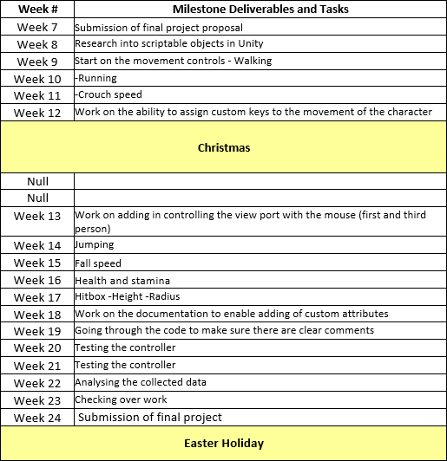
Original
Project Timeline
Revised
Notes:
Because of this feedback I revised my timeline to include testing and analysis weeks towards the end of the project
I also re-arranged the order of some of the other weeks around based on my current work and what I though was more of a priority.

Slide 7




What has been done so far?
Notes:
So, what has been done so far?

Slide 8
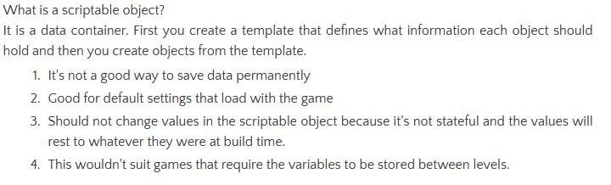
Researching scriptable objects
Would have been useful for making multiple of one type of object e.g.
A group of enemies
Cards in hearthstone
Notes:
First off I researched into scriptable objects
It’s a data container
You first create a template that defines what information each object should hold
And then you create objects from that template
Not a good way to store data permanently
Good for default settings that load with the start of the game
Should not change the values in the scriptable object because they are stateful and the values will reset to what they were at build time
This wouldn’t suit games that require the variables to be stored between levels

Slide 9
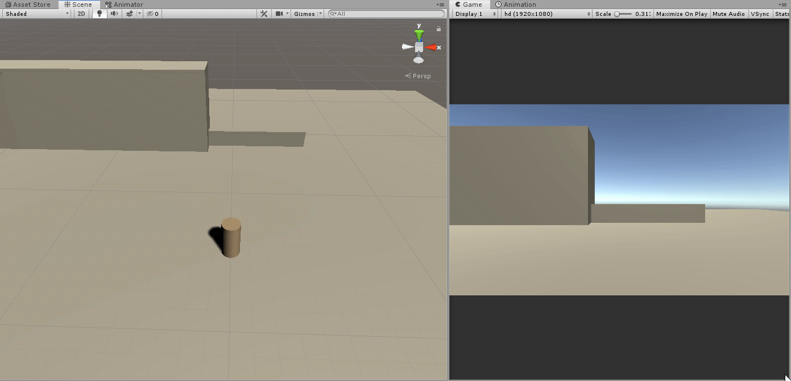
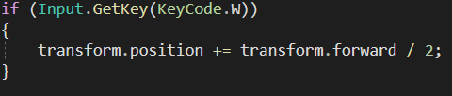
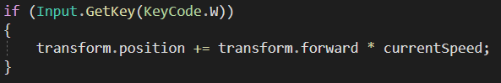
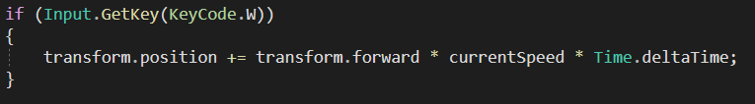
Walking
Notes:
First of all I started on making a character walk around the scene.
I used Unit’s inbuilt “Get Key” function to define what key would perform the action
The first iteration didn’t allow for the user to change the speed
SO the next iteration I made a speed variable which allows the user to enter a custom speed they want
Then in the third iteration I made sure to times by Time.deltaTime so it would perform consistently regardless of frame rate.

Slide 10
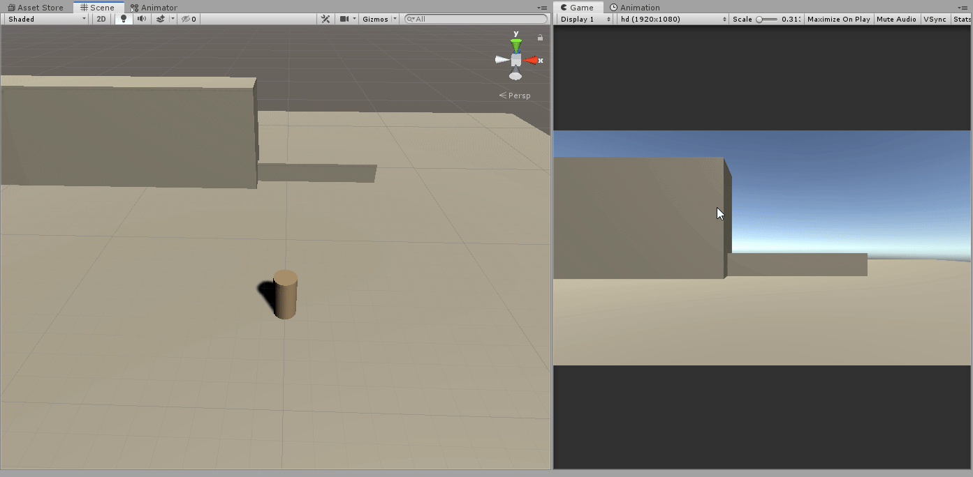
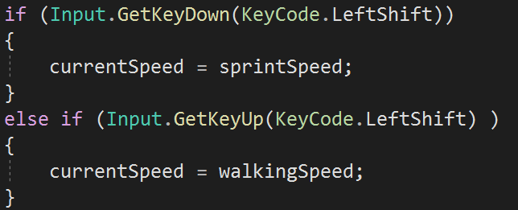
Running
Notes:
Next I implemented the running function

Slide 11

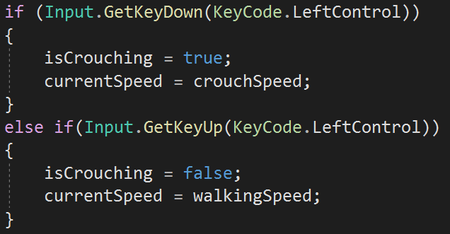
Crouching

Slide 12
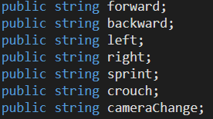
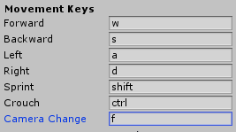
Adding custom controls
Notes:
I started by using strings for the custom controls, which meant the user could type in any control they wanted. I thought this would make it easier for them however, I quickly found out that this approach still requires knowledge of what unity calls each key.
And if the user types on the wrong name, it quickly breaks the entire script.

Slide 13
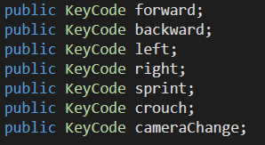
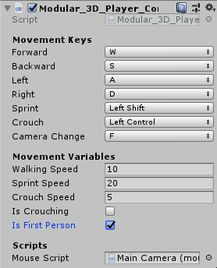
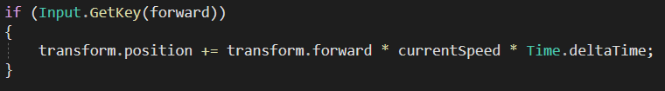
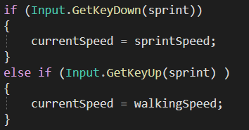
Assigning custom controls - cont.
Notes:
After doing some research I found a way to combat this error. I used Keycodes which map directly to a physical key on the keyboard.
When using this approach it gives the user less room for error as they now have a list that is defined by unity
https://docs.unity3d.com/ScriptReference/KeyCode.html

Slide 14
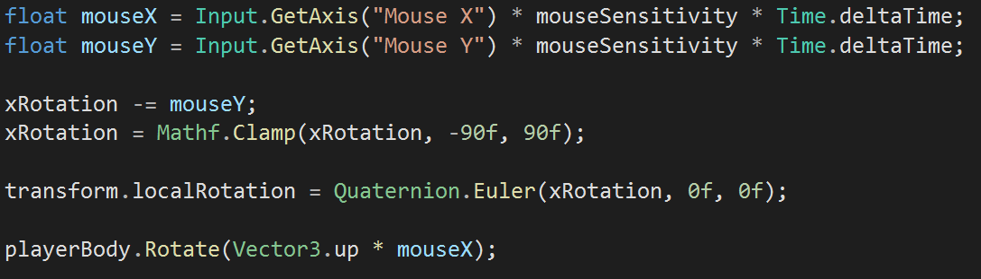
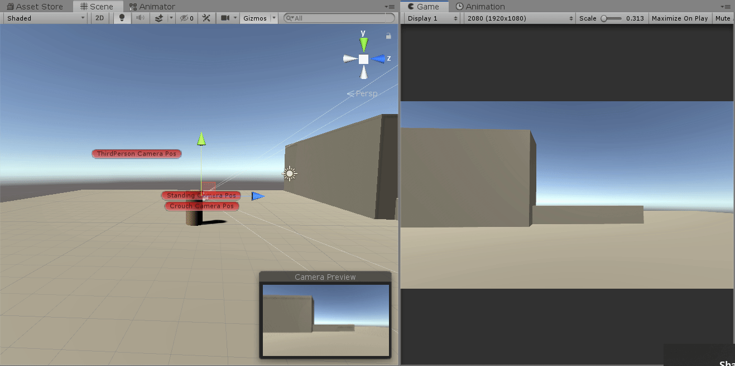
Camera movement

Slide 15
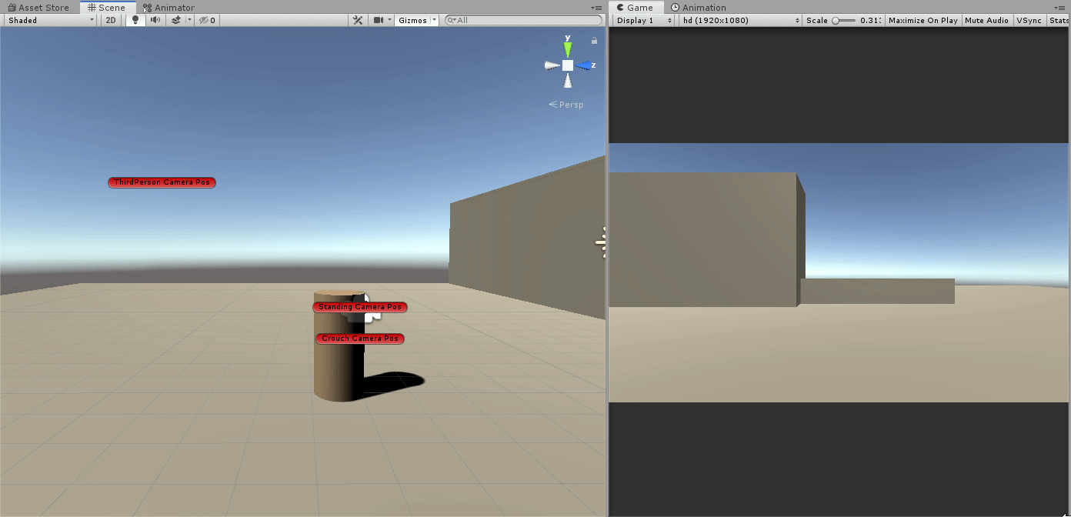
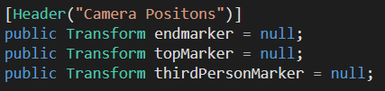
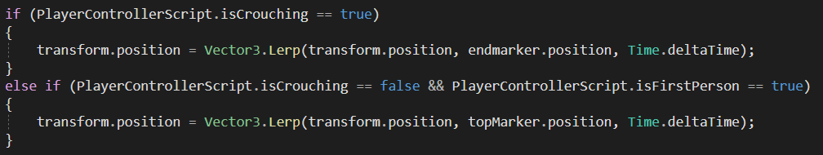
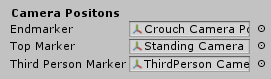
Camera movement – Cont.

Slide 16
Blogs
All of the work shown here can be seen in more detail in my weekly blogs on my website, along with references to where I researched the topics

Slide 17
Project Plan – What's left?
Notes:
So what’s left to do?

Slide 18
What still needs to be added to the controller
Answering the question
Jumping
Gravity
Health and stamina
Hitbox –height –radius
Write documentation
Comment the code
Test Controller
Test Controller
Analyse the collected data
Check over work
Submit the project
Two weeks
Notes:
This is everything that is still left to do
On the left is what still needs to be added to the controller on a week by week basis
Based on the work already completed I am on track with my revised project timeline
Providing that goes well I can start the tasks on the right which is my testing phase
On the right is my “Testing” Phase where I will begin testing my
I have allowed myself a week at the end for error checking

Slide 19
Questions?

